Slide 1
Using built-in Excel tools
Functions:
RAND(): generates a random numbers between 0 and 1.
Inverse probability functions: NORM.INV(), BETA.INV(), BINOM.INV(), F.INV(): compute a value from a given distribution
Example:
NORM.INV(0.3, 0, 1): computes the value that follows a normal distribution with mean of 0 and standard deviation of 1, and has a probability of 0.3
NORM.INV(RAND(), 0, 1): generate a random variable that follows a normal distribution with mean of 0 and standard deviation of 1

Slide 2
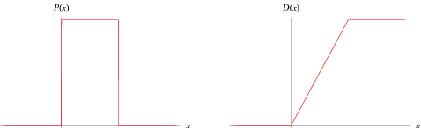
Random Variables in Excel http://www.tvmcalcs.com/index.php/calculators/apps/generating-random-variates-in-excel-using-built-in-functions
RAND(): Yields a (pseudo)random value between 0 and 1 in Excel. Hence, RAND() follows a uniform distribution between 0 and 1.
RAND() is used as the starting point to generate random variables that follow other distributions.
Uniform distribution between a and b: a + (b-a)*RAND()

Slide 3
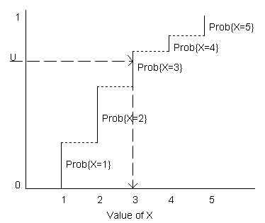
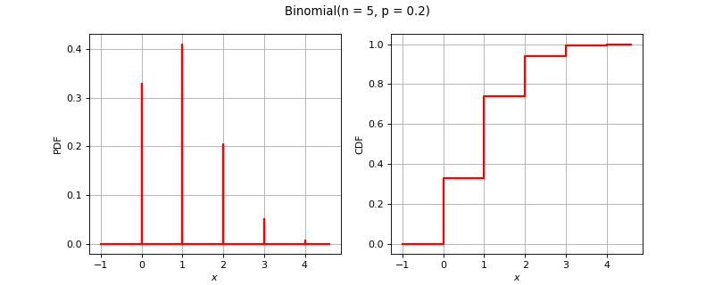
Random Variables in Excel
Discrete random variable with distribution: VLOOKUP(RAND(), TABLE, 2, TRUE)
Binomial random variable with n trials and probability of success per trial, p: BINOM.INV(RAND(), n, p)
CDF* | Value | Probability
0 | 1 | .3
.3 | 2 | .4
.7 | 3 | .2
.9 | 4 | .05
.95 | 5 | .05

Slide 4
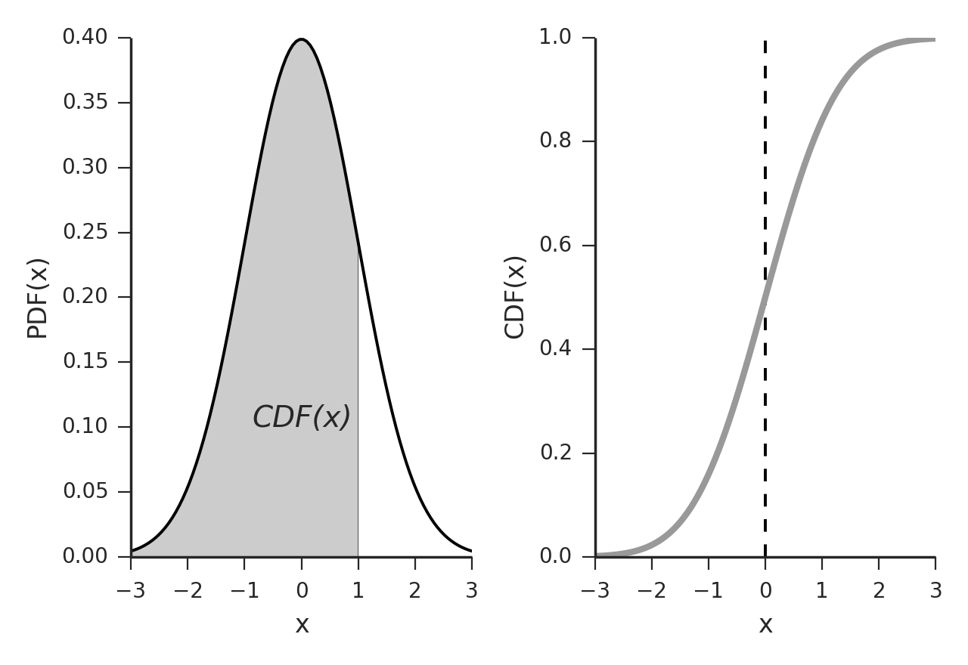
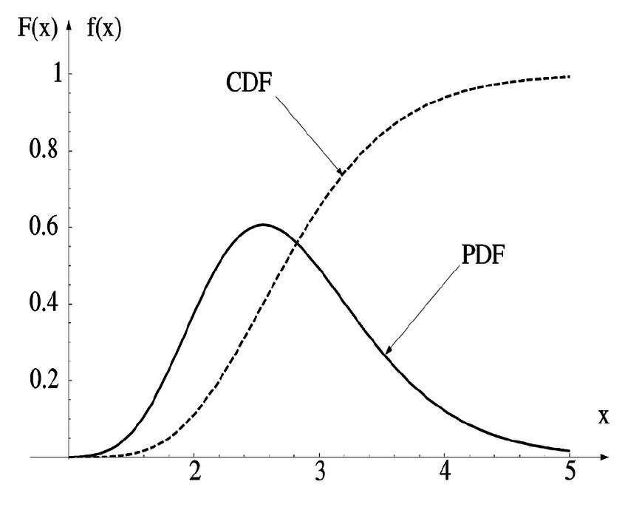
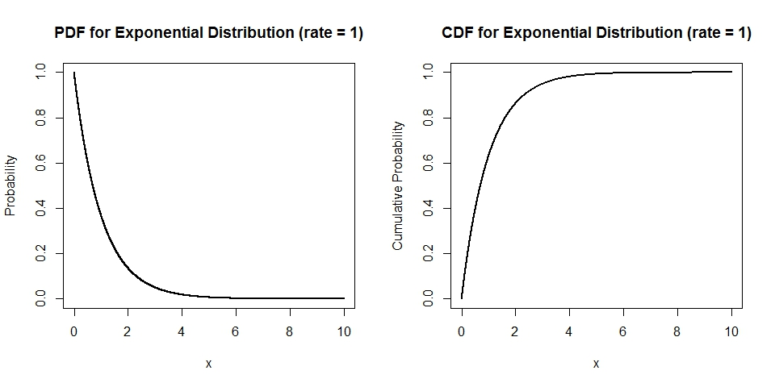
Random Variables in Excel
Normal distribution with mean, µ, and standard deviation, σ: NORM.INV(RAND(), µ, σ)
Lognormal distribution with mean, µ, and standard deviation, σ: LN(LOGNORM.INV(RAND(), µ, σ))
Exponential distribution with parameter, λ:
-1/LAMBDA*LN(1-RAND())

Slide 5
Using built-in Excel tools
Summary table:
AVERAGE(): expected values
STDEV.S(): standard deviation of a sample
COUNTIF(): count the values that meet a condition

